Slide 1




भारत सरकार
GOVERNMENT OF INDIA
सूक्ष्म, लघु और मध्यम उद्यम मंत्रालय
MINISTRY OF MICRO, SMALL & MEDIUM ENTERPRISES
एमएसएमई-विकास कार्यालय, अहमदाबाद
MSME- DEVELOPMENT & FACILITATION OFFICE, AHMEDABAD
https://msme.gov.in/
dcdi-ahmbad@msme.gov.in
079 27544248, 079 27543147

Slide 2




Connect over Social Media Platform
@ MSME-DFO AHMEDABAD

Slide 3
MSME At A Glance
Govt. of India, Ministry of MSME formulates policies & various schemes for the development & growth of Indian MSMEs.
O/o Development Commissioner, MSME New Delhi is the Nodal agency for implementation of policies & schemes formulated by GOI, Ministry of MSME throughout the country.
MSME-Development & Facilitation Office, Ahmedabad having two Branch offices i.e. Br. MSME-DFO, Rajkot & Br. MSME-DFO, Silvassa to provide extension services in the state of Gujarat as well as at UT- Dadra & Nagar Haveli & UT: Daman & Diu.

Slide 4

IMPORTANCE OF MSMEs
Indian Micro, Small, and Medium Enterprises (MSMEs) play a vital role in the country's economic growth and development.
Here are some key importance of Indian MSMEs:
REGIONAL DEVELOPMENT
DIVERSIFICATION OF ECONOMY
COMPETITIVENESS
SKILL BUILDING
WOMEN EMPOWERMENT
NATIONAL GROWTH
INNOVATION & ENTREPRENEURSHIP
EXPORT GROWTH
EMPLOYMENT GENERATION
CONTRIBUTION TO GDP

Slide 5

PRESENT SCENARIO OF INDIAN ECONOMY
India's Economic Growth: A Strong First Quarter
The Indian economy is currently experiencing a period of resilience and growth. According to recent reports, India's GDP grew by 6.7% in the first quarter of fiscal 2024-2025, driven by strong private consumption growth, which increased by 7.4% year-over-year.¹
OPTIMIZATION OF PRODUCTION CAPACITIES BY 76.4% , PICKUP IN PRIVATE INVESTMENTS
INCREASE IN RURAL CONSUMPTION LEAD BY ROBUST AGRICULTURAL OUTPUT
KEY DRIVERS OF GROWTH
GOVERNMENT INITIATIVES LED TO INCREASE IN JOB CREATION
REBOUNDING LABOUR MARKET TRADES
ELEVATED INFORMAL EMPLOYMENT
CHALLENGES & OPPORTUNITIES
FLUCTUATIONS IN GLOBAL TRENDS
SOURCE:
ARTICLE BY
WORLD ECONOMIC FORUM

Slide 6



MSME SECTORS CONTRIBUTION TO INDIAN ECONOMY
2nd
Largest Employer after Agriculture
24+ Cr
Employment
(Udyam Portal & UAP)
5.8+ Cr
MSMEs Registered on Udyam/Udyam Assist
*National Statistical Office, Ministry of Statistics & Programme Implementation
**Data culled out Portal of Directorate General of Commercial Intelligence and Statistics (DGCIS)

Slide 7

Major Schemes of Ministry of MSME
Entrepreneurship
(Entrepreneurship & Skill Development Programme, Assistance to Training Institutions)
Whole of the Government Approach
(Raising & Accelerating MSME Performance,
PM Vishwakarma)
Finance
(Credit Guarantee Scheme,
Self Reliant India Fund)
Technology
(Schemes for Technology Centres and Extension Centres)
Marketing
(Procurement & Marketing Support Scheme
International Cooperation,
National SC/ST Hub)
Employment Generation
(PM Employment Generation Programme, Khadi Gram Vikas Yojana)
Infrastructure
(Cluster Development Programme, Scheme for North East)

Slide 8
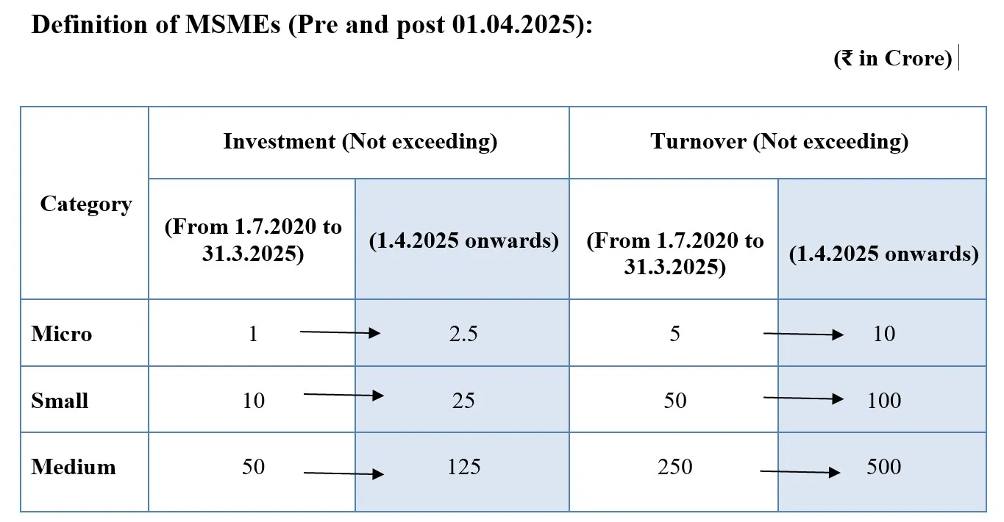
Definition of MSME
MSMEs Classification based on Investment in Plant & Machinery and Turnover
Notification CG-DL-E-21032025-261838 Date: 21.04.2025

Slide 9
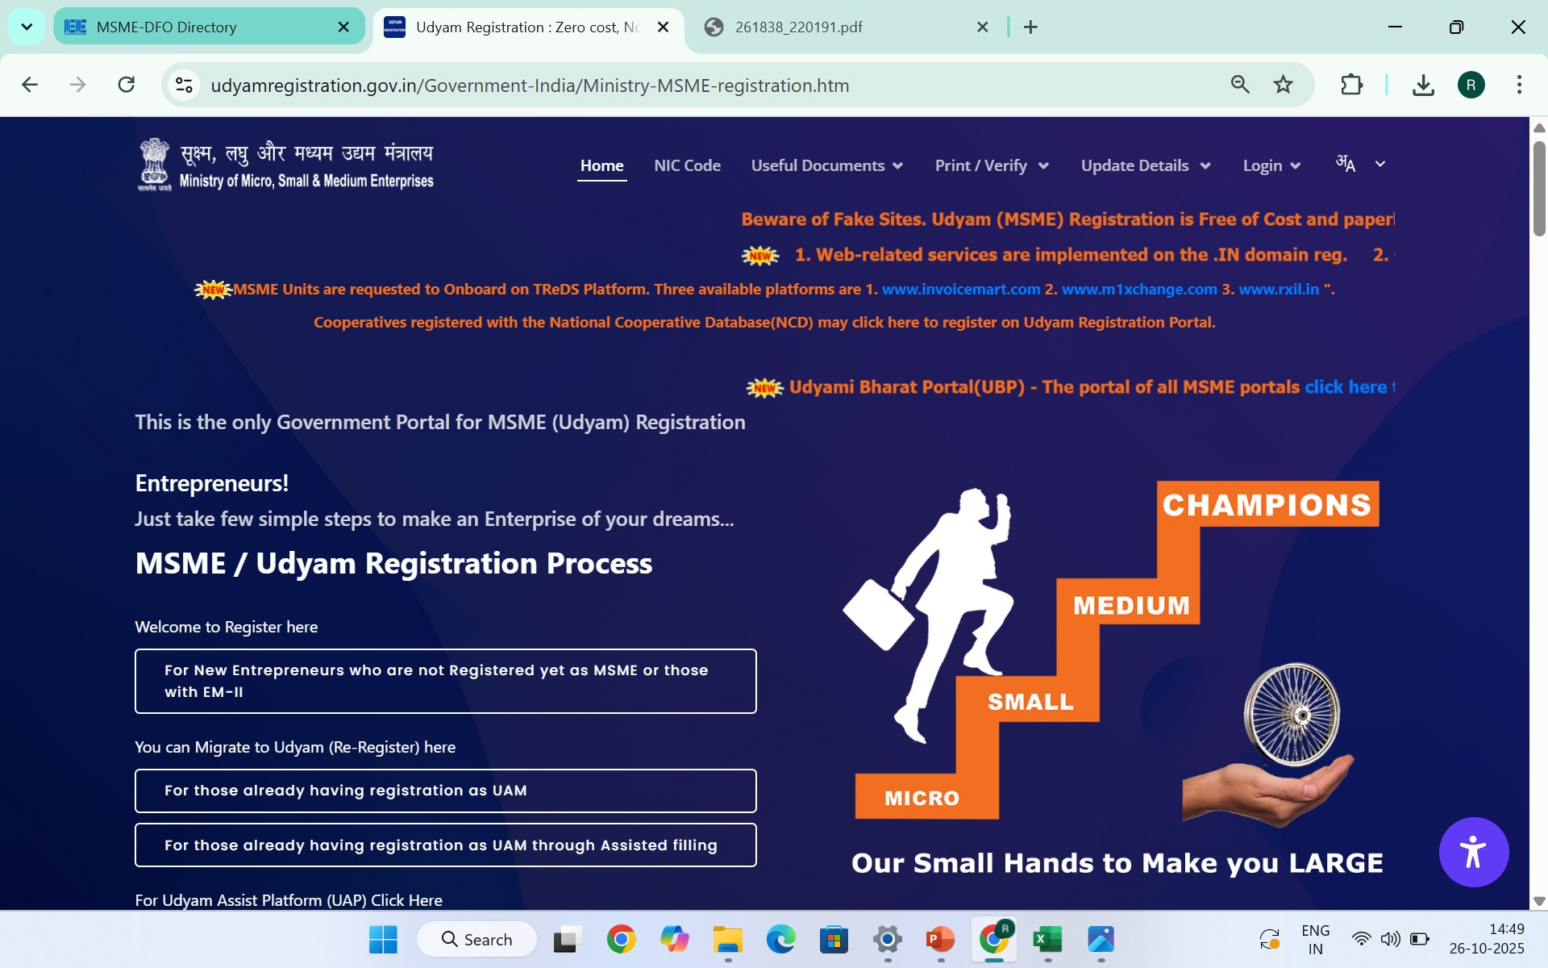
UDYAM Registration Portal

Slide 10
About UDYAM Registration
The form for registration shall be as provided in the Udyam Registration portal (i.e. udyamregistration.gov.in)
Registration is online, free of cost, paperless and user-friendly. No need for Renewal.
Can be filed on self-declaration basis. No documentation or proof are required.
Required Documents for the Filing URC:-
Aadhaar Number and details of an Entrepreneur (As latest updated)
PAN details of an Entrepreneur/ Firm (As latest updated)
Bank details of an Entrepreneur/ Firm
Mobile number linked with Aadhaar of an Entrepreneur
No enterprise shall file more than one Udyam Registration: Provided that any number of activities including manufacturing or service or both may be specified or added in one Udyam Registration.
All the units with GSTIN listed against same PAN shell be collectively treated as one Enterprise and Aggregate Value of all such Entities will be considered for deciding Category.
PAN & GST linked details on investment & turnover of enterprises taken automatically from Govt data bases.
Whoever intentionally misrepresents or attempts to suppress the self-declared facts and figures appearing in the Udyam Registration or updation process shall be liable to such penalty as specified under section 27 of the Act.

Slide 11
About UDYAM Registration
Govt. has now provided the exemption from the requirement of having GSTIN as per the provisions of the Central Goods and Services Tax Act, 2017.
In case of any proprietorship enterprise not registered under any Act or rules of the Central /State Government, the proprietor may use his or her PAN for registration of the enterprise in the Udyam Registration portal and for all other types of enterprises PAN shall be mandatory.
The expression plant and machinery or equipment of the enterprise, shall have the same meaning as assigned to the plant and machinery in the IT Rules, 1962 framed under the IT Act, 1961 and shall include all tangible assets (other than land and building, furniture and fittings).
The value of Plant & Machinery or Equipments shall mean the Written Down Value (WDV) as at the end of the FY as defined in the Income Tax Act and not the cost of acquisition or original price,.

Slide 12
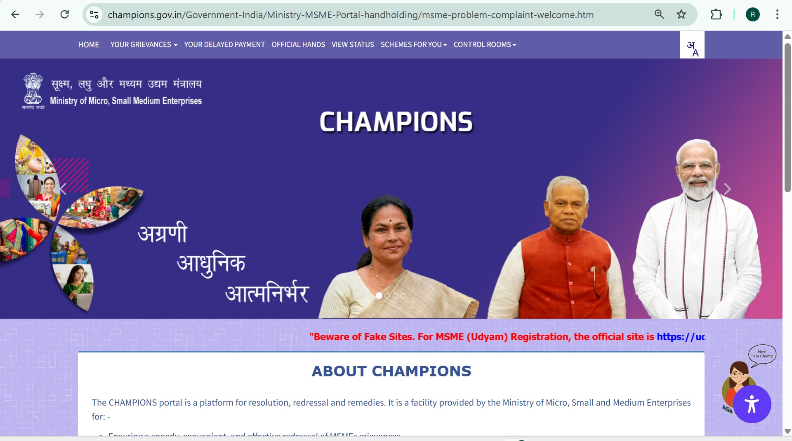
Champions Portal

Slide 13
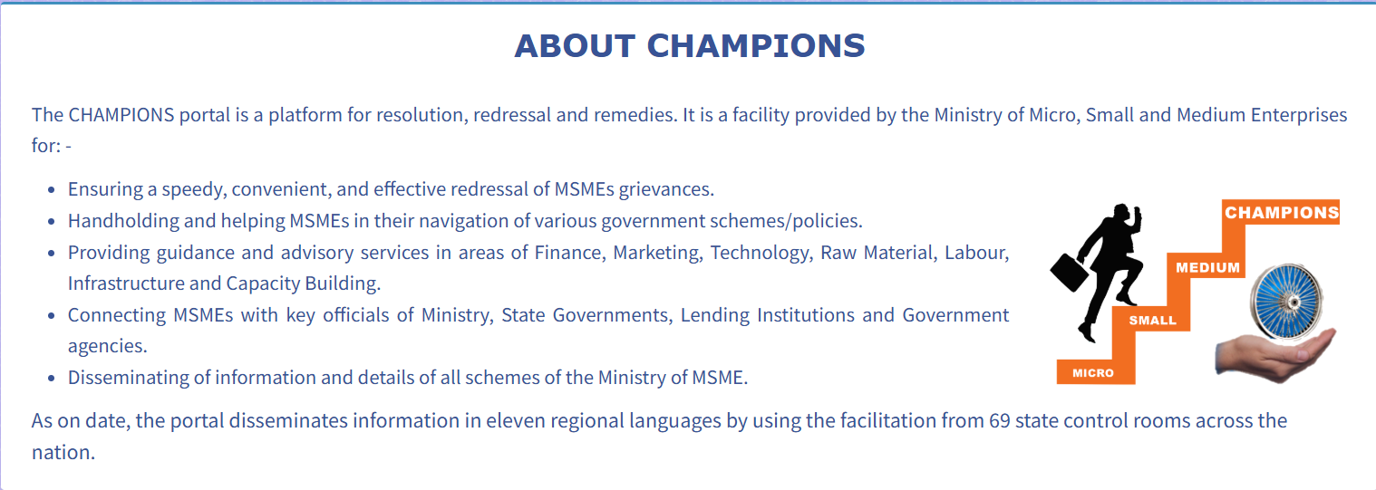

Slide 14
Central Schemes of MSMEs
Sr. N | Schemes
1 | Prime Minister Employment Generation Programme and Other Credit Support Schemes
2 | Marketing Promotion Schemes
3 | Technology Upgradation and Quality Certification
4 | Entrepreneurship and Skill Development Programs
5 | Micro & Small Enterprises Cluster Development (MSE-CDP)
6 | National Award Scheme
7 | Technology Centres/ Extension Centres (TCEC)
8 | Scheme of Surveys, Studies and Policy Research
9 | Promotion of MSMEs in NER and Sikkim
10 | MSE-SPICE (RAMP Programme)
Source: M/o MSME > Schemes

Slide 15


Prime Minister Employment Generation Programme
PMEGP is a major credit-linked subsidy programme aimed at generating self-employment opportunities through establishment of micro-enterprises in the non-farm sector. The scheme is implemented by Khadi and Village Industries Commission (KVIC) functioning as the nodal agency at the national level. At the state level, the scheme is implemented through State KVIC Directorates, State Khadi and Village Industries Boards (KVIBs), District Industries Centres (DICs) and banks.
Nature of assistance | I) For setting up of new micro enterprise (units) The maximum cost of the project/unit admissible in manufacturing sector is ₹ 50 lakh and, in the business,/service sector, it is ₹ 20 lakh. II) 2nd Loan for upgradation of existing PMEGP/MUDRA units The maximum cost of the project/unit admissible for Margin Money subsidy under Manufacturing sector for upgradation is Rs. 1.00 crore. The maximum cost of the project/unit admissible for Margin Money subsidy under Business/Service sector for upgradation is Rs. 25 lakh.
Who can apply? | Individuals aged 18+. Minimum education: Class VIII for manufacturing projects over ₹10 lakh or business/service projects over ₹5 lakh. Not eligible: Units that received subsidies under PMRY or other central/state schemes. Eligible for second loan: Existing PMEGP, REGP, or MUDRA units.
How to apply? | PMEGP e-portal (http://www.kviconline.gov.in/pmegpeportal/jsp/pmegponline.jsp)

Slide 16

Credit Guarantee Scheme for Micro & Small Enterprises
The scheme aims to provide credit guarantees for the credit facilities extended to MSEs by the Member Lending Institutions (MLIs), without the requirement of collateral security or third-party guarantees. With effect from 01.04.2025, this scheme facilitates credit guarantees for credit support of upto Rs. 10 crore to MSEs, extended by the MLIs.
Category (including Trading activity) | Maximum extent of Guarantee Coverage | Maximum extent of Guarantee Coverage | Maximum extent of Guarantee Coverage
 | where credit facility is | where credit facility is | where credit facility is
 | Upto ₹ 5 lakh | Above ₹ 5 lakh & upto ₹ 50 lakh | Above ₹ 50 lakh & upto ₹ 10 crore
Micro Enterprises | 85% | 75% | 75%
MSEs located in North East Region, UT of Jammu & Kashmir & UT of Ladakh | 80% | 80%
Women entrepreneurs / MSE promoted by Agniveers | 90% | 90% | 90%
SC/ST entrepreneurs / Person with Disability (PwD)/ MSEs situated in Aspirational District / ZED certified MSEs | 85% | 85% | 85%
All other category of borrowers | 75% | 75% | 75%
The extent of guarantee coverage for MSEs situated in Identified Credit Deficient Districts (ICDD) by RBI is additional 5% over and above the applicable guarantee coverage wef December 15, 2023 (i.e for guarantee coverage of 75%, the coverage would be 80%, for 80% it would be 85% and for 85% it would be 90%) | The extent of guarantee coverage for MSEs situated in Identified Credit Deficient Districts (ICDD) by RBI is additional 5% over and above the applicable guarantee coverage wef December 15, 2023 (i.e for guarantee coverage of 75%, the coverage would be 80%, for 80% it would be 85% and for 85% it would be 90%) | The extent of guarantee coverage for MSEs situated in Identified Credit Deficient Districts (ICDD) by RBI is additional 5% over and above the applicable guarantee coverage wef December 15, 2023 (i.e for guarantee coverage of 75%, the coverage would be 80%, for 80% it would be 85% and for 85% it would be 90%) | The extent of guarantee coverage for MSEs situated in Identified Credit Deficient Districts (ICDD) by RBI is additional 5% over and above the applicable guarantee coverage wef December 15, 2023 (i.e for guarantee coverage of 75%, the coverage would be 80%, for 80% it would be 85% and for 85% it would be 90%)

Slide 17
Interest Subsidy Eligibility Certificate (ISEC)
The Interest Subsidy Eligibility Certificate (ISEC) Scheme is an important mechanism of funding khadi programme undertaken by khadi institutions. It was introduced to mobilise funds from banking institutions for filling the gap between the actual fund requirements and availability of funds from budgetary sources.
Nature of assistance | Under the ISEC Scheme, credit at a concessional rate of interest of 4% per annum for working capital, is made available as per the requirement of the institutions. The difference between the actual lending rate and 4% is paid by the Central Government through KVIC to the lending banks.
Who can apply? | The Khadi institutions, having valid Khadi certificate and sanctioned khadi programme. The Institutions registered with the KVIC/State Khadi and Village Industries Boards (KVIBs) can avail of financing under the ISEC Scheme, the Scheme supports only the khadi and the polyvastra sector.
How to apply? | The Khadi institutions will apply to the financing bank for working capital alongwith the ISEC certificate issued by KVIC. Based on the working capital sanctioned, financing bank will raise the reimbursement claim to the nodal branch for the differential interest rate over and above 4%.

Slide 18
Procurement & Marketing Support Scheme (PMS)
Promoting new market access initiatives like organizing / participation in National / International Trade Fairs / Exhibitions / MSME Expo, etc. held across the country. To create awareness and educate the MSMEs about importance / methods/ process of packaging in marketing, latest packaging technology, import-export policy and procedure, GeM portal, MSME Conclave, latest developments in international / national trade and other subjects / topics relevant for market access developments.
Nature of assistance | 1. 80% subsidy on built up space rent paid for General & 100% for SC/ST/Women/PH/Aspirational District and 100% contingency expenditure for Trade fairs (Micro & Small Enterprises) 2. Financial assistance of 80% of one-time registration fee and annual recurring fee ( for first 3 years) for adoption of Bar Code (Micro enterprises) 3. Financial assistance on annual membership fee/subscription fee/ contingency expenses (photography, cataloguing, advertising, etc.) for selling their products or services by Micro Enterprises.
Scheme Components | Market Access Initiatives across the country. a. Trade fairs/ exhibitions. b. Vendor Development Program (VDP) Development of Retails outlet. | 3. Capacity Building. a. Adoption of Modern Packaging Techniques. b. Adoption of Bar Code. c. Adoption of e-Commerce Platform. d. National Workshops/ Seminars.
Who can apply? | Manufacturing/ Service sector MSEs having valid Udyam Registration (UR) Certificate.
How to apply? | Through online, URL: https://my.msme.gov.in/MyMsme/Reg/COM_ViewEvent.aspx

Slide 19
Procurement & Marketing Support Scheme (PMS)
Domestic Trade fairs/ exhibitions
Nature of assistance | Reimbursement of Stall Rent (Minimum size of stall) up to 80 % or actual whichever is lower to General category & Max. 100 % to SC/ST/Women/NE MSEs limited to Rs. 20,000/- or actual which ever is lower.I (In case of Technology Trade fairs /Exhibitions maximum limit of Stall rent will be Rs. 50,000/- ) Contingency expenditure up to Rs. 25,000/- will be reimburse for all category: On the basis of Actual or whichever is lower. Owner or representative will be eligible for AC II Tier Rail fares as a travelling expenditure, including publicity materials. Maximum Budgetary Support: Metro & A Class Cities : Rs. 1.50 Lac or Actual whichever is less. Other Cities: Rs. 0.80 Lac or Actual whichever is less.
International Trade Fair/Exhibition or Buyers-Sellers Meet in abroad:
Nature of assistance | The expenditure to be incurred wherever the Ministry decides to organize or participate on its own will be decided by the Empowered Committee, subject to the overall ceiling prescribed by the Deptt. of Expenditure (If applicable). The scale of assistance to participating MSEs in MSME pavilion will be admissible as detailed in space rent subsidy and contingency expenditure as above under para 5.0 (I)(A) above.

Slide 20
Procurement & Marketing Support Scheme (PMS)
Vendor Development Program
Type of VDPs |  | Program Duration | Scale of Assistance
CPSE level Vendor Development Program cum Exhibition of Products |  | 2 Days | Sanction of max. Rs 5.0 lakh / program or actual, whichever is less, per program. Each program would consist of training on various aspects related to GeM and exhibition of Products. VDP should benefit MSMEs in their GeM registration and detailed understanding of Public Procurement with CPSEs
Adoption of Modern Packaging Technique:
Nature of assistance | Sanction of max. Rs 15 lakh / cluster or actual, whichever is less depending on the type of approved cluster. Empaneled packaging expert organizations like IIP, NID, NIFT and other similar organizations shall sign an MoU with O/o DC (MSME) and, accordingly, provide the consultancy services to the approved clusters supported by the Ministry under its various schemes.
Target Beneficiary | Clusters based on Food Processing, Toys, Handicrafts, Kitchen and home utenciles, Ceramic, Glass, Gem & Jewelry, Textiles and apparels, Medical Equipment, Sports Goods etc.

Slide 21
Procurement & Marketing Support Scheme (PMS)
Adoption of Barcode:
Unit based interventions for BarCode. |  | Providing financial assistance of 80% of one-time registration fee and annual recurring fee (for first three years) paid by micro enterprises for obtaining up to 100 Nos. of bar codes (i.e. products) or actual whichever is less subject to Rs. 50,650/- (Fifty thousand six hundred and fifty) max.
Eligibility |  | Micro enterprises which have UDYAM Registration and also have registration with GS1 India for use of Bar Codes.
Adoption of E-Commerce platform:
Nature of assistance | Providing financial assistance on annual membership fee/subscription fee / contingency expenses (photography, cataloguing, advertising etc.) for selling their products or services by Micro Enterprises (up to 10 new products) through e-commerce portal "MSME Global Mart" being operated by National Small Industries Corporation.
Eligibility | Micro Enterprises with valid Udyam Registration.
National Workshops/ Seminars:
Scale of assistance: Rs. 5.0 lakh max. or actual, whichever is less per workshop/seminar, anywhere in the country. Assistance is admissible to the Govt. / Non - Govt. reputed organizations having at least 3 years of experience in organizing subject specific workshops / seminars.

Slide 22
International Cooperation Scheme
Nature of assistance | IC Scheme provides financial assistance on reimbursement basis for airfare, space rent, freight charges, advertisement & publicity charges, entry/registration fee, registration-cum-membership certificate charge/fee, export insurance premium on reimbursement basis.
Scheme Components | Global Exhibitions & Trade Meets: India-Based International Events: Overseas Mega Events: Ministry-Led Delegations: Organising international conferences/summits/ workshops/seminars in India OR in abroad by Ministry of MSME, its organizations solely or in partnership with industry associations for promotion of MSME sector. | Capacity Building of First Time Exporters (CBFTE) Reimbursement of Registration-cum-Membership Certificate charges/ Fees (first-time MSE exporters) Reimbursement of export insurance premium paid by MSEs. Reimbursement of fee paid on Testing & Quality Certification acquired by MSEs to export products.
Who can apply? | Government Institutions, Registered Industry Associations, Export Promotion Councils associated with promotion and development of MSME sector.
How to apply? | Applications for availing financial assistance are invited on IC Scheme portal i.e. https://ic.msme.gov.in

Slide 23

MSME SUSTAINABLE (ZED) CERTIFICATION
Objectives | Promote quality manufacturing using advanced technologies with minimal environmental impact. Build a ZED ecosystem to boost MSME competitiveness and export readiness. Recognize MSMEs adopting ZED practices and incentivize higher certification levels. Raise public awareness about Zero Defect, Zero Effect products. Support government policy and investment decisions through performance insights.
Nature of assistance | Cost of Certification a) a) Certification Level 1: BRONZE: Rs. 10,000/- b) b) Certification Level 2: SILVER: Rs. 40,000/- c) c) Certification Level 3: GOLD: Rs. 90,000/- Subsidy on cost of ZED certification: • Joining Reward of Rs. 10,000/- (Bronze will become free if availed) • 80-60-50% for Bronze, Silver & Gold ZED certified MSMEs | Additional subsidy : • 10% for Women/SC/ST owned MSMEs OR MSMEs in NER/Himalayan/LWE/Island territories/aspirational districts. • 5% for MSMEs which are also a part of the SFURTI OR Micro & Small Enterprises - Cluster Development Programme (MSE-CDP) of the Ministry
Who can apply? | All MSMEs registered with the UDYAM registration portal (of the M/o MSME)
How to apply? | Eligible MSMEs shall apply through online portal : https://loginzed.msme.gov.in/Msme/Login

Slide 24

MSME-COMPETITIVE (LEAN)
Objectives | MSME Competitive (Lean) Scheme is an extensive drive on the part of Ministry of Micro, Small and Medium Enterprises for enhancing the competitiveness of MSME Sectors through implementation of Lean Tools and Techniques. Lean Tools and Techniques are a tested and proven methodology for improving the competitiveness of MSME sector.
Nature of assistance | Cost of Implementation: Basic-Free; Intermediate- Rs. 1,20,000/-; Advance- Rs. 2,40,000/- Financial Assistance to group of MSME Units for adoption of Lean tools/techniques Subsidy on cost of Implementation: 90% of Total Cost of Implementation
Who can apply? | All MSMEs registered with the UDYAM registration portal (of the M/o MSME)
How to apply? | Eligible MSMEs shall apply through online portal

Slide 25
MSME- Innovative (Incubation, IPR, Design and Digital MSME)
Objectives | MSME Innovative is a new concept for MSMEs with a combination of innovation in incubation, design intervention and by protecting IPR in a single mode approach to create awareness amongst MSMEs about India’s innovation and motivate them to become MSME Champions. This will act as a hub for innovation activities facilitating and guiding development of ideas into viable business proposition that can benefit society directly and can be marketed successfully.
Nature of assistance | Incubation • Financial Assistance to HI for developing and nurturing the ideas- up to maximum of Rs. 15 lakh per idea. • Financial assistance for Plant and Machinery to HI up to Rs. 1.00 cr. (max) - shall be provided for BI for R&D activities and common facilities for incubatees of BI. Design • Design Project: 75% of the total project cost will be contributed by GoI up to a maximum of Rs. 40 lakh • Student Project: 75% of the total project cost will be contributed by GoI up to a maximum of Rs. 2.5 lakh IPR: Reimbursement for registration of Patent, Trademark, Geographical Indications (G.I.), Design:
Maximum Financial Assistance | Foreign Patent: Rs. 5.00 lakh Domestic Patent: Rs. 1.00 lakh | iii. GI Registration: Rs. 0.15 lakh iv. Design Registration: Rs. 0.10 lakh
Who/ How to apply? | All MSMEs registered with the UDYAM registration portal (of the M/o MSME) | Eligible MSMEs shall apply through online portal

Slide 26
Entrepreneurship Skill Development Programme (ESDP)
Objectives | The programme is to motivate young persons (Men and Women) representing different sections of the society to consider self-employment or entrepreneurship as one of the career options. The core objective is to promote new enterprises, build capacity of existing MSMEs and inculcate entrepreneurial culture in the country.
Assistance | Name of the ESDP Component | Duration of Training | Particulars of Programme
1 | Entrepreneurship Awareness Programme (EAP) | One Day | Participants: - 50-100 Mostly Conducted by MSME-DFOs and some IAs.
2 | Entrepreneurship cum Skill Development Programme (E-SDP) | Minimum 6 Weeks | Participants: - 25-30 (Minimum 25) Mostly Conducted by MSME-DFOs and some IAs.
3 | Management Development Programme (MDP) | Minimum One Week | Participants: - 25-30 (Minimum 25) Mostly Conducted by MSME-DFOs and some IAs.
4 | Advance E-SDP | Minimum One Week | Participants: About 20/ 25 Conducted by Implementing Agencies (IAs) like IITs/IIMs/ICAR/BARC/NIMSME/NIESBUD/Central & State Agricultural Universities, etc.
5 | Advance MDP | Minimum One Week
Who/ How to apply? | Aspiring and existing entrepreneurs, MSME owners looking to scale their businesses/ starting a business. |  | Interested candidates may contact MSME-DFOs, Technology Centres, and Implementing Agencies for registration.

Slide 27
Micro & Small Enterprises Cluster Development (MSE-CDP)
1. Common Facility Centers (CFCs): The GoI grant will be restricted to 70% of the cost of project from Rs. 5.00 crore to Rs. 10.00 crore and 60% of the cost of project from Rs. 10.00 crore to Rs. 30.00 crore. In case of Aspirational Districts, NER, Hill States, Island territories, LWE affected districts and clusters with more than 50% (a) micro/ village or (b) women owned or (c) SC/ST owned units, GoI grant will be 80% of the cost of project from Rs. 5.00 crore to Rs. 10.00 crore and 70% of the cost of project from Rs. 10.00 crore to Rs. 30.00 crore.
Nature of assistance | Hard interventions, i.e., setting up of CFCs with maximum eligible project cost of Rs 30.00 cr with GoI contribution of 70% (80% for special category States and for clusters with more than 50% women/micro/village/ SC/ST units). Infrastructure development in the new/ existing industrial estates/areas in which the maximum eligible project cost is Rs 15.00 cr, with GoI contribution amounting to 60% of project cost (70% for special category States and for clusters with more than 50% women/micro/SC/ST units).
Who can apply? | Group of MSEs of clusters, State Government/State Government Agencies
How to apply? | Online applications can be filled at https://cluster.dcmsme.gov.in , Website: http://dcmsme.gov.in/CLCS_TUS_Scheme/Cluster-Development-Programme/Scheme_Guideline.aspx

Slide 28
Micro & Small Enterprises Cluster Development (MSE-CDP)
2. Infrastructure Development: The GoI grant will be restricted to 60% of the cost of project from Rs. 5.00 crore to Rs. 15.00 crore for setting up of new Industrial Estate / Flatted Factory Complex and GoI grant will be 50% of the cost of project from Rs. 5.00 crore to Rs. 10.00 crore for up-gradation of existing Industrial Estate / Flatted Factory Complex. In case of Aspirational Districts, NER, Hill States, Island territories, LWE affected districts and clusters with more than 50% (a) micro/ village or (b) women owned or (c) SC/ST owned units, GoI grant will be 70% of the cost of project from Rs. 5.00 crore to Rs. 15.00 crore for setting up of new Industrial Estate / Flatted Factory Complex and 60% of the cost of project cost from Rs. 5.00 crore to Rs. 10.00 crore for up-gradation of existing Industrial Estate / Flatted Factory Complex.
Nature of assistance | Hard interventions, i.e., setting up of CFCs with maximum eligible project cost of Rs 30.00 cr with GoI contribution of 70% (80% for special category States and for clusters with more than 50% women/micro/village/ SC/ST units). Infrastructure development in the new/ existing industrial estates/areas in which the maximum eligible project cost is Rs 15.00 cr, with GoI contribution amounting to 60% of project cost (70% for special category States and for clusters with more than 50% women/micro/SC/ST units).
Who can apply? | Group of MSEs of clusters, State Government/State Government Agencies
How to apply? | Online applications can be filled at https://cluster.dcmsme.gov.in , Website: http://dcmsme.gov.in/CLCS_TUS_Scheme/Cluster-Development-Programme/Scheme_Guideline.aspx

Slide 29
Technology Centres/ Extension Centres (TCEC)
Establishment of New Technology Centres/ Extension Centres(TCEC). • The scheme envisages establishment of 20 new Technology Centres (TCs) and 100 Extension Centres (ECs) at an estimated total outlay of the scheme, Rs. 3500 Crores. • The primary objective of the scheme is to increase the geographic reach of TCs network to provide solution as per local needs of MSMEs for technology, skilled human resources, and advisory services. This will increase competitiveness and profitability of MSMEs at grass root level.
1. Technology Centers: The Technology Centres(TCs) are to be established in PAN India. Land for Technology Centres at identified locations is to be provided by State Governments free of cost on long term lease basis. The TCs shall provide solution as per local needs of MSMEs for technology, skilled human resources, and advisory services. |  | 2. Extension Centres (ECs): Extension centers are extended facilities of Technology Centres in unserved areas. The Extension Centres are established with relatively smaller investments to cover wider geographical area and to meet local specific requirements. The Extension Centres (ECs) are to be accommodated in buildings available with State Government/ MSME-DIs/ TCs / Government ITIs/ Govt. Polytechnics and other similar facilities.
Nature of assistance | Primary focus of these TCs and ECs are to support industries, particularly MSMEs in the through: Providing access to Advanced Manufacturing Technologies Skilling of manpower in technology development; and Providing technical and business advisory support to MSMEs
Who can apply? | • MSMEs • Skill Seekers. The interested MSMEs and Trainees may avail facilities directly from concerned TC or EC.

Slide 30
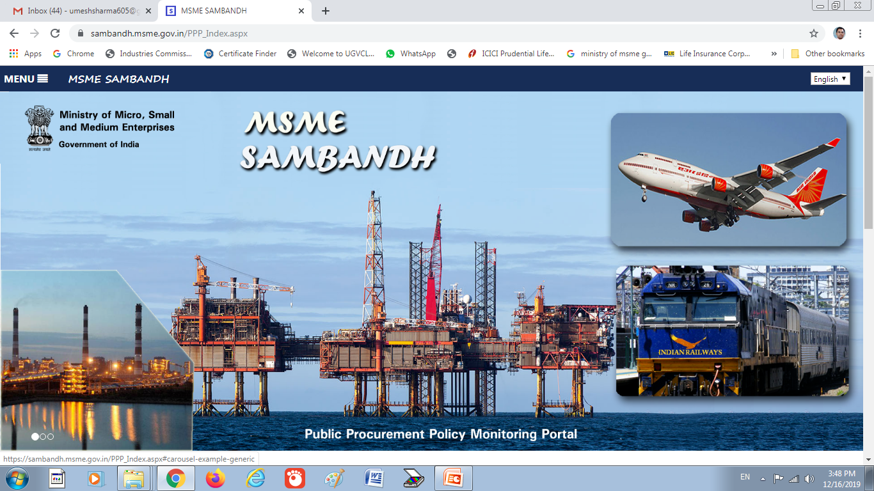
Public Procurement Policy

Slide 31
Public Procurement Policy
Central Government Ministries, Department and Public Sector Undertaking shall procure minimum 25 % (w.e.f 09.11.2018) of their annual value of goods and services from Micro & Small Enterprise.
04% from SC/ST, 03% from Women out of 25 % is earmarked for procurement from MSEs enterprise.
In tender, participating MSEs quoting price within price bend of L1+15 % shall be allowed to supply 25% of total tender value by bringing down their price to L1
To reduce transaction cost of doing business MSEs shell be facilitated by providing tender set free of cost and exempting MSEs from payment of earnest money.

Slide 32
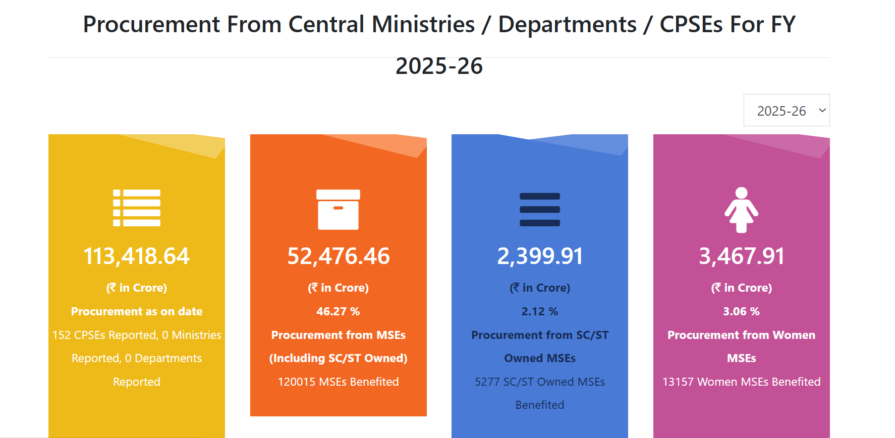
Public Procurement Policy

Slide 33



Trade Receivables electronic Discounting System (TReDS)
A trade receivables electronic discounting system (TReDS) is an online platform where Micro, Small, and Medium Enterprises (MSMEs) can get their unpaid invoices, or trade receivables, discounted electronically for immediate cash flow.
Companies with a turnover over ₹250 crore are mandated to register on these platforms.
Participants:
Sellers: Only MSMEs
Buyers: Corporates, Government Departments, and Public Sector Undertakings (PSUs) with a turnover of over ₹250 crore are required to register.
Financiers: Banks, Non-Banking Financial Company-Factors (NBFC-Factors), and other financial institutions authorized by the RBI.
"MSME Units are requested to Onboard on TReDS Platform. Three available platforms are 1. www.rxil.in 2. www.m1xchange.com 3. www.invoicemart.com ".

Slide 34
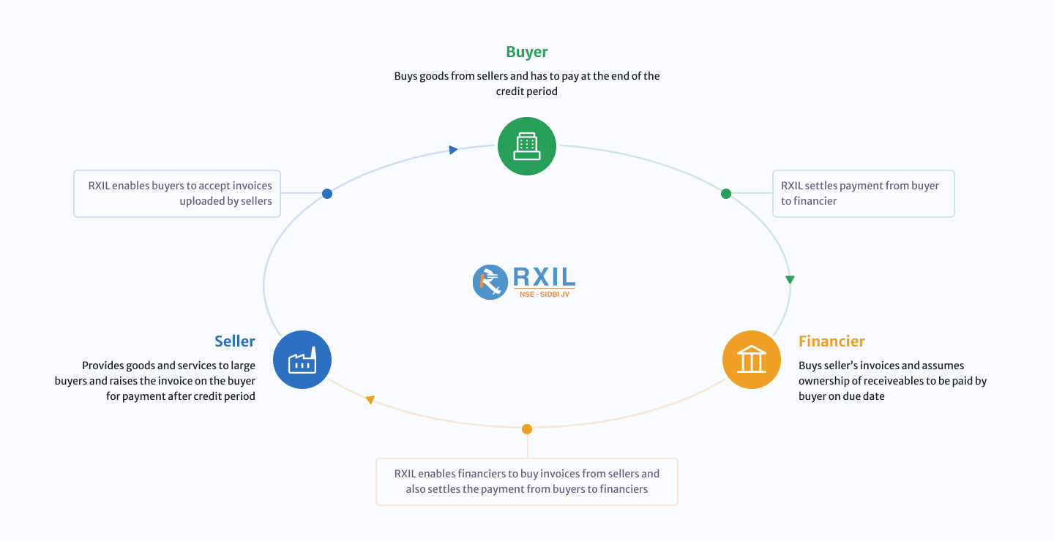
Who can register on TREDS? MSMEs engaged for at least 1 year since its date of registration in following categories can register on TReDS.

Slide 35
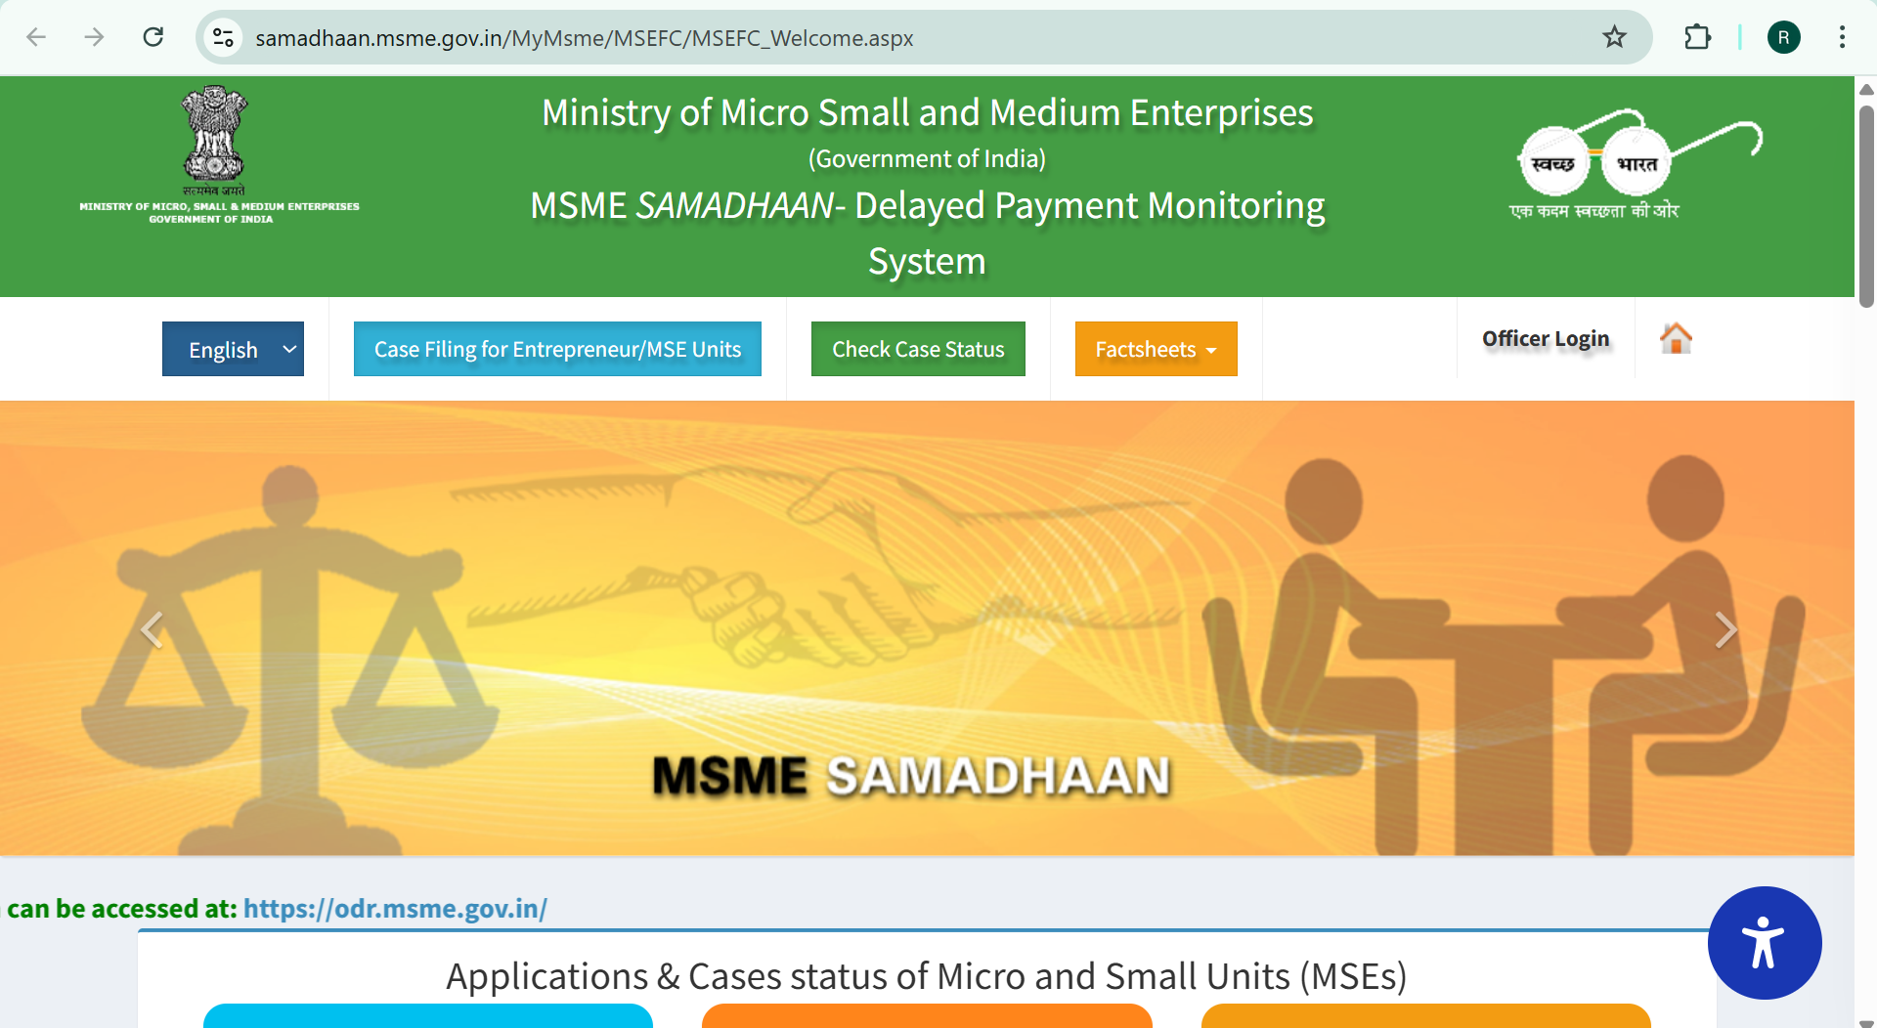
MSME SAMADHAAN- Delayed Payment Monitoring System

Slide 36
MSME SAMADHAAN- Delayed Payment Monitoring System
Related Provision
The Micro, Small and Medium Enterprise Development (MSMED) Act, 2006 contains provisions of Delayed Payment to Micro and Small Enterprise (MSEs). (Section 15- 24). State Governments to establish Micro and Small Enterprise Facilitation Council (MSEFC) for settlement of disputes on getting references/filing on Delayed payments. (Section 20 and 21)
Nature of assistance
MSEFC of the State after examining the case filed by MSE unit will issue directions to the buyer unit for payment of due amount along with interest as per the provisions under the MSMED Act 2006.
Who can apply
Any Micro or small enterprise having valid Udyam Registration can apply.
MSME Samadhaan Portal - Ease of filing application under MSEFC, an Initiative from Ministry of MSME, Govt. of India
Ministry of MSME has taken an initiative for filing online application by the supplier MSE unit against the buyer of goods/services before the concerned MSEFC of his/her State/UT. These will be viewed by MSEFC Council for their actions. These will be also visible to Concerned Central Ministries, Departments, CPSEs, State Government, etc for pro-active actions.
The MSMED Act, 2006 (Dealing with Delayed Payment)

Slide 37

MSE Scheme for Promotion and Investment in Circular Economy (MSE-SPICE)
A sub scheme under “Raising and Accelerating MSE Performance (RAMP)”
An initiative by India's Ministry of Micro, Small & Medium Enterprises (MoMSME) to encourage Micro and Small Enterprises (MSEs) to adopt circular economy principles. Its main goal is to promote resource efficiency and reduce environmental impact by providing incentives for recycling, reusing, and reducing waste, particularly in sectors like plastic, rubber, and e-waste.
Scheme Components:
I) Credit Linked Capital Subsidy: Provides financial assistance to MSEs for adopting circular solutions, with a subsidy of 25% on the cost of plant and machinery for eligible projects.
II) Information, Education, and Communication (IEC): Organizes awareness programs and provides information to address capacity gaps and promote the benefits of circular economy practices.
Target sectors: Focuses on sectors with high waste potential, including plastic, rubber, and electronic waste, but also covers other materials like municipal solid waste, scrap metal, and solar panels.
Eligibility: All Micro and Small Enterprises registered on the UDYAM portal are eligible to apply.
Financial support: For brownfield projects, the maximum project cost for a 25% subsidy is ₹50 Lakhs. Projects costing more than this are also eligible, but the subsidy is capped at ₹12.5 Lakhs.

Slide 38

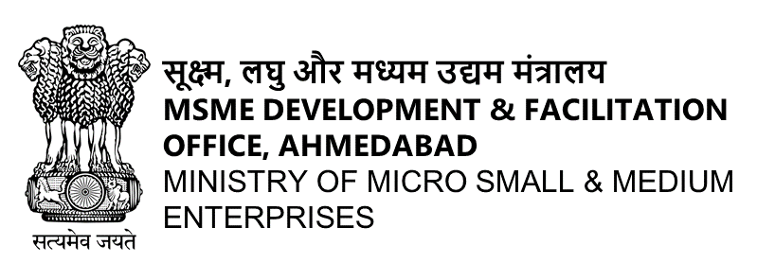
MSME Tower, Nr. CIMS Hospital, Science City Road, Sola, Ahmedabad, Gujarat- 380060.
धन्यवाद
Thank You

